Slide 1
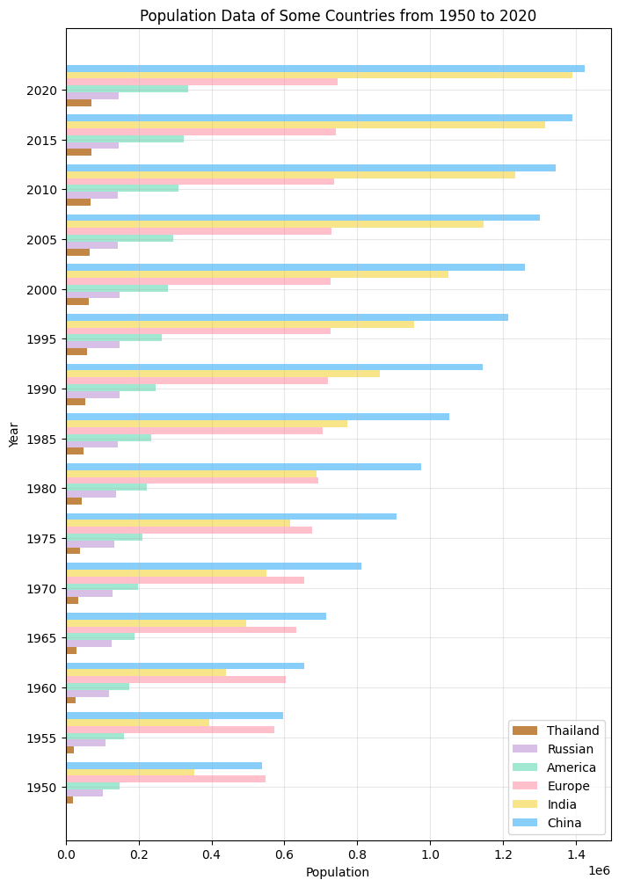
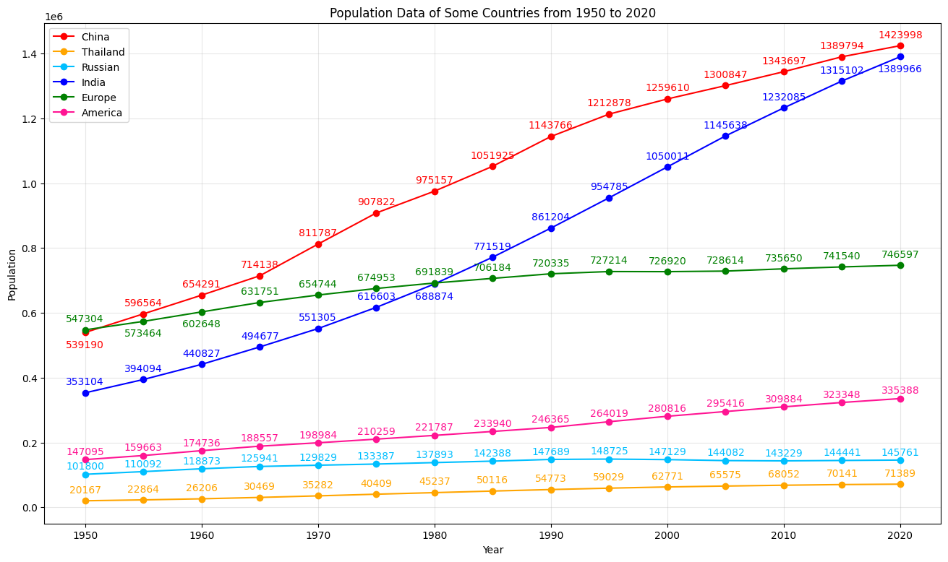
Both figures show changing of the population of the countries over years
The line plot focuses on showing the trend of population changes over time, while the bar plot focuses on showing the differences in population in different countries in the same year.
Overall, as the year increases, the country’s population gradually increases.
Populations in India and China continue to grow significantly, while other countries tend to remain stable.
For each year, the population rankings between countries remain essentially unchanged, except India and Europe.
Shiyun Zhang
Notes:
Hello everyone, I’m Shiyun Zhang. My presentation today is about the Visualization of Population Data of Some Countries from 1950 to 2020.
Here’s two figures and we can see that Both figures show the changing of population data of the countries over years. Overall, as the year increases, the country’s population gradually increases.
Then we can analyze the first figure, it’s a line plot, which focuses on showing the trend of population changes over time.
From this figure, we can see that populations in India and China continue to grow significantly, while other countries tend to remain stable.
The second figure is a bar plot, which focuses on showing the differences in population in different countries in the same year.
From the bar plot, we can see that for each year, the population rankings between countries remain essentially unchanged. Except India's population surpassed Europe's in 1985.

Slide 2
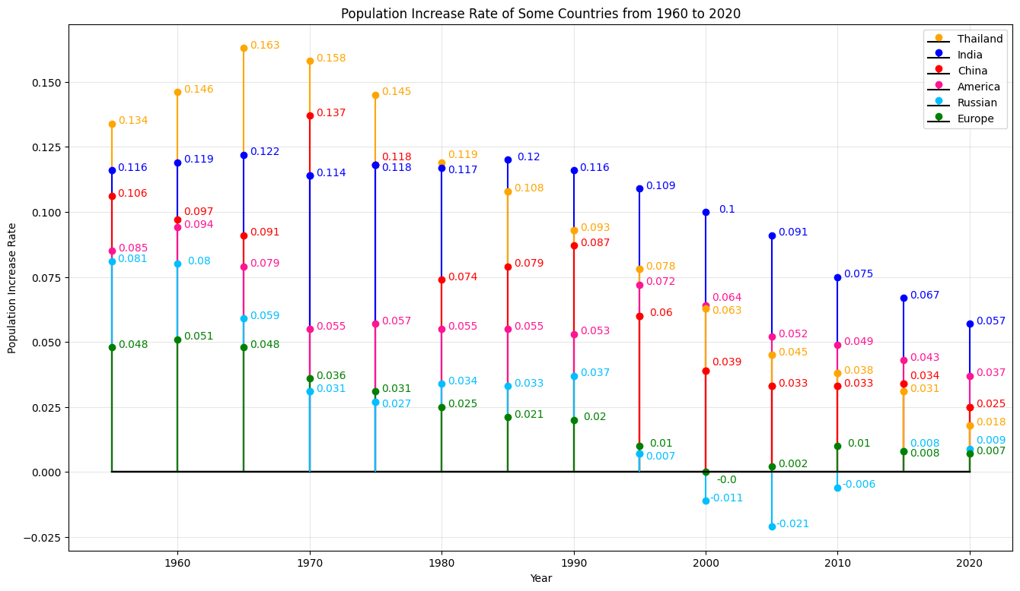
Conclusions:
Through these three figures, people can more intuitively and clearly understand the changing trends of population data of different countries in different years.
Dataset:
https://www.kaggle.com/datasets/shivd24coder/worldwide-population-data
Github link:
https://github.com/shz173/2415-final-project
This stem plot shows the trend of population growth rate in different countries from 1960 to 2020.
Positive values indicate that the population has increased during this decade, while negative values indicate the opposite.
Overall, as the year increases, the population growth rate gradually decreases.
Shiyun Zhang
Notes:
This stem plot here shows the trend of population growth rate in different countries from 1960 to 2020.
In this figure, Positive values indicate that the population has increased during this decade, while negative values indicate the opposite.
We can find that: Overall, as the year increases, the population growth rate gradually decreases.
Through these three figures, people can more intuitively and clearly understand the changing trends of population data of different countries in different years.
And following is the dataset link and the github link of my work.

